Slide 1
WELCOME TO END OF TERM PARTY
Welcome new members: Chihiro, Jadeyn, Morgan, Meagan, Tyne, Fenqi, Han
Welcome back old members: Samantha, Danielle
See you again: Janitta, Samuel
Simon Fraser University
Summer 2023
Notes:
Visual saliency/vowel tensity
English Vowels Effects of Word Frequency on Vowel Adaptations

Slide 2
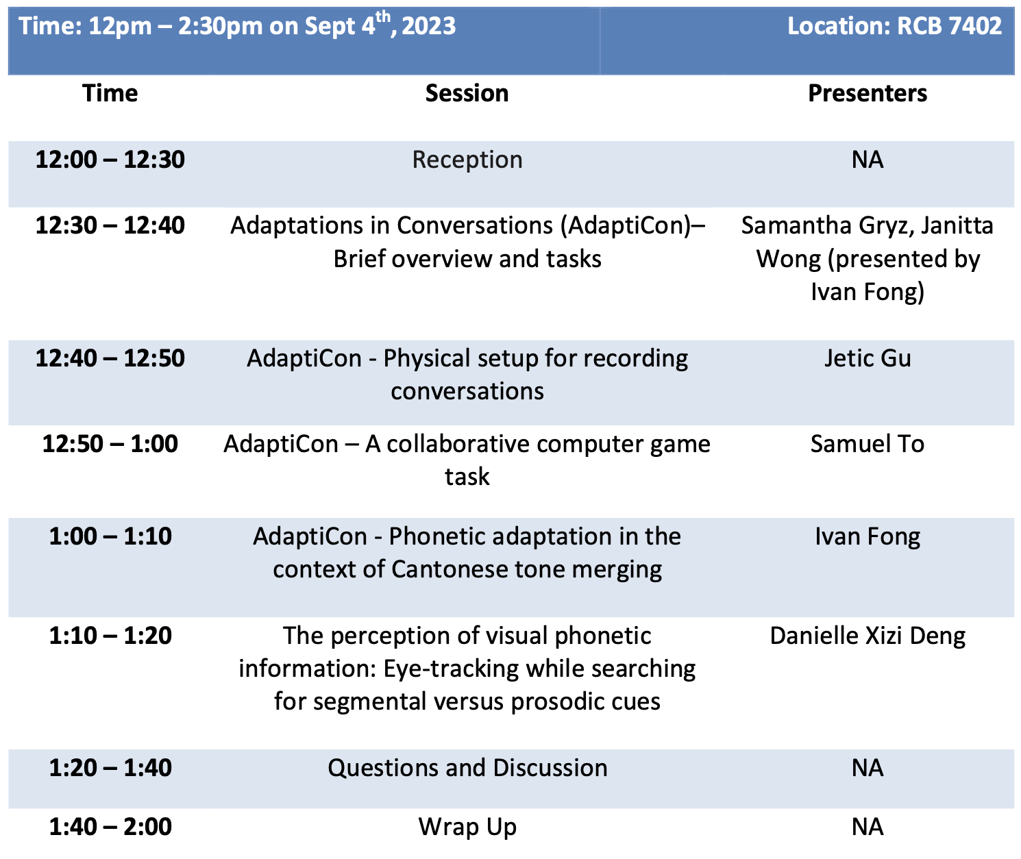

Slide 3
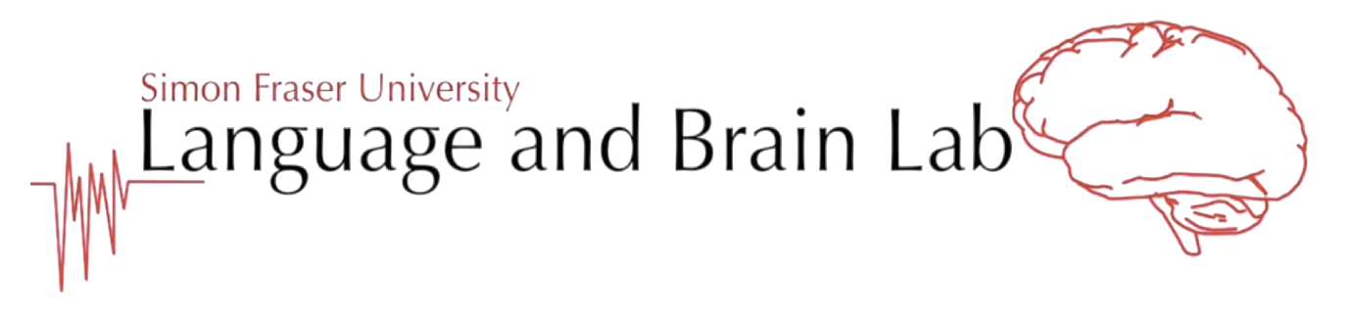
Adaptations in conversation Experimental tasks
Group members: Janitta Wong & Samantha Gryz
*Thanks to Ivan for presenting!*
Simon Fraser University
August 2023
Notes:
Visual saliency/vowel tensity
English Vowels Effects of Word Frequency on Vowel Adaptations

Slide 4
Introduction
Phonetic convergence, or adaptation, is defined as “an increase in segmental and suprasegmental similarity of the speech of one talker to another” (Pardo, 2006).
Past research has found that adaptation in conversation involves a few factors, including conversational roles, gender, dominance in conversational, dialect formation, temporal factors, and social relationships (Labov 1976, 1984; Giles, Coupland and Coupland, 1991)
The present study specifically considers English vowel articulation in a natural conversational setting
Complimenting experiments consider phonetic adaptation in Cantonese tones, and conversational adaptation between computer-based AI and human participants.
Notes:
Janitta
Phonological neighbourhood density: “refers to the number of words that differ from a target word by a single phoneme”
ie. cat compared to scat, at, coat, cap (Munson & Soloman, 2004)
Do we include? How?
We predict that adaptation in auditory only vs. audio-visual conditions will…(?)
instead of AxB perception tests, compare visual cues of vowel formants(?) of speaker 1’s first utterance vs speaker 2’s first utterance vs speaker 1’s last utterance of target words (audiovisual condition)
Also compare speaker 1’s pre-task utterance vs speaker 2’s utterance vs speaker 1’s post-task utterance (audio-only?)

Slide 5
Phonetic adaptions
Interlocutors adapt to each other’s speech through the processes of
- convergence, by approximating their partner’s pronunciation, or
- divergence, by emphasizing sound distinctions (e.g., clear speech)
Notes:
Janitta
Phonological neighbourhood density: “refers to the number of words that differ from a target word by a single phoneme”
ie. cat compared to scat, at, coat, cap (Munson & Soloman, 2004)
Do we include? How?
We predict that adaptation in auditory only vs. audio-visual conditions will…(?)
instead of AxB perception tests, compare visual cues of vowel formants(?) of speaker 1’s first utterance vs speaker 2’s first utterance vs speaker 1’s last utterance of target words (audiovisual condition)
Also compare speaker 1’s pre-task utterance vs speaker 2’s utterance vs speaker 1’s post-task utterance (audio-only?)

Slide 6
Example
Hypothetical scenario (Y. Wang, 2022)
Conversation between a vowel “merger” (Dawn=Don /a/) and a “non-merger” (Dawn /ɔ/ vs. Don /a/).
Confusions prompt adaptations
Another example: flapping, e.g., metal - medal
Notes:
Janitta
Phonological neighbourhood density: “refers to the number of words that differ from a target word by a single phoneme”
ie. cat compared to scat, at, coat, cap (Munson & Soloman, 2004)
Do we include? How?
We predict that adaptation in auditory only vs. audio-visual conditions will…(?)
instead of AxB perception tests, compare visual cues of vowel formants(?) of speaker 1’s first utterance vs speaker 2’s first utterance vs speaker 1’s last utterance of target words (audiovisual condition)
Also compare speaker 1’s pre-task utterance vs speaker 2’s utterance vs speaker 1’s post-task utterance (audio-only?)

Slide 7
Research question
How do interlocutors adjust their speech in the course of a conversation to improve intelligibility
- e.g., when speaking with someone of a different dialect, nonnative speaker, AI
- in different communicative contexts (e.g., noisy cafeteria)
Notes:
Janitta
Phonological neighbourhood density: “refers to the number of words that differ from a target word by a single phoneme”
ie. cat compared to scat, at, coat, cap (Munson & Soloman, 2004)
Do we include? How?
We predict that adaptation in auditory only vs. audio-visual conditions will…(?)
instead of AxB perception tests, compare visual cues of vowel formants(?) of speaker 1’s first utterance vs speaker 2’s first utterance vs speaker 1’s last utterance of target words (audiovisual condition)
Also compare speaker 1’s pre-task utterance vs speaker 2’s utterance vs speaker 1’s post-task utterance (audio-only?)

Slide 8
Hypotheses
What is the degree to which talkers adjust their English vowel articulations in natural conversation with (1) high and low frequency words and (2) different noise conditions?
Main hypotheses:
Based on previous findings from Kim et al. (2011) and Munson & Solomon (2004), we predict that the extent of vowel modifications will be greater in higher frequency words and in noisier conditions
Sub-hypotheses for more specific predictions:
We predict that greater vowel adaptation will occur in beginning vs. end of conversation target words between interlocutors with greater noise levels (or with different L1 backgrounds) (Kim et al., 2011)
We predict that higher frequency words will result in productions with longer vowel duration and a contracted vowel space when compared to lower frequency words (Munson, 2004)
Notes:
Janitta
Phonological neighbourhood density: “refers to the number of words that differ from a target word by a single phoneme”
ie. cat compared to scat, at, coat, cap (Munson & Soloman, 2004)
Do we include? How?
We predict that adaptation in auditory only vs. audio-visual conditions will…(?)
instead of AxB perception tests, compare visual cues of vowel formants(?) of speaker 1’s first utterance vs speaker 2’s first utterance vs speaker 1’s last utterance of target words (audiovisual condition)
Also compare speaker 1’s pre-task utterance vs speaker 2’s utterance vs speaker 1’s post-task utterance (audio-only?)

Slide 9
Participants
English non-merger and merger speakers (who flap and do not)
Inclusion Criteria:
Right-handed
Between 18 to 35 years
Native English speakers - those who grew up in a dominant English-speaking environment (regardless of heritage language)
Must not have visual, hearing or speech impairments
Notes:
Sam
Stimuli acquired in pre- and post- tasks at the word level, and in both semi-scripted and unscripted natural conversational sentences
Stimuli must be: monosyllabic; CVC; high frequency; object (easily visualized); target different vowels; use minimal or pseudo-minimal pairs; be found in a similar consonantal context
Specific phonetic contrasts: tense and lax vowels in minimal or near minimal pairs/monosyllabic nouns
beet - bill /bit/ (tense) -/bɪl/ (lax)
“These words contain 2 kinds of vowels, distinctive in both audio and visual data collection” (cite?)
This stimuli was chosen to meet the above conditions, but also because the vowels chosen are distinctive enough in both audio and visual data

Slide 10
Experiment overview
Examine adaptation between a “flapper” and a “non-flapper”
Natural conversation through two game-like tasks:
- Guess what card game and Diapix
- involving collaborative problem solving and repetition of target stimuli
Why two different experimental tasks?
Encourage natural conversation with different levels of structure
Allow for repetition of stimuli, collaboration between participants, and back-and-forth problem-solving through conversation
Notes:
Janitta
We want to pilot two alternative tasks - both of which encourage natural conversation between participants, but with different levels of structure; both allowing for repetition of stimuli, teamwork, and back-and-forth problem solving through conversation.
Experiment 1 is more controlled vs Experiment 2 is more spontaneous -

Slide 11
Stimuli
Acquired in
Pre- and post-tasks at the word level
Both semi-scripted and unscripted natural conversational sentences
Criteria:
Must be monosyllabic; CVC; high frequency (target) and low frequency (non-target); object (easily visualized)
Target different vowels; use minimal or pseudo-minimal pairs; be found in a similar consonantal context
Specific phonetic contrasts: flapping (t/d contrast) in minimal or near minimal pairs/monosyllabic nouns
Visual stimuli is created using online resource Irasutoya (https://www.irasutoya.com/) and Canva (https://www.canva.com)
Notes:
Sam
Stimuli acquired in pre- and post- tasks at the word level, and in both semi-scripted and unscripted natural conversational sentences
Stimuli must be: monosyllabic; CVC; high frequency; object (easily visualized); target different vowels; use minimal or pseudo-minimal pairs; be found in a similar consonantal context
Specific phonetic contrasts: tense and lax vowels in minimal or near minimal pairs/monosyllabic nouns
beet - bill /bit/ (tense) -/bɪl/ (lax)
“These words contain 2 kinds of vowels, distinctive in both audio and visual data collection” (cite?)
This stimuli was chosen to meet the above conditions, but also because the vowels chosen are distinctive enough in both audio and visual data

Slide 12
Current Stimuli List - 7 Flapping Pairs
Focused on a t/d contrast:
Batter / Badder
Butter / Budder
Latter / Ladder
Litre / Leader
Metal / Medal
Petal / Pedal
Writer / Rider
Notes:
Increase variation
Flapping - medal/metal, writer/rider,
Challenge of finding participants who do or do not “flap” - do we choose participants who only “flap”, or don’t “flap”
bough/bow not great bc of pronunciation of bow
Balance contrast bw pairs generally
Focus on devoicing for demo
Fricatives instead of stops, ie. bus/buzz
Issue of aspiration - ie. bag/back
Moving forward: Final consonant devoicing with fricatives (ie. bus/buzz) and flapping
Demo a diapix scene with sentences - WH questions
For recording demo:
2 cameras
2 mics
2 computers/2 sets of stimuli

Slide 13
Stimuli List - 9 Filler pairs
Focused on minimal pairs: ɑ-ʌ, i-ɪ and u-ʊ.
Sheep / Ship
Pill / Peel
Pick / Peak
Mill / Meal
Pitch / Peach
Chick / Cheek
Suit / Soot
Poppy / Puppy
Bin / Bean
Notes:
Increase variation
Flapping - medal/metal, writer/rider,
Challenge of finding participants who do or do not “flap” - do we choose participants who only “flap”, or don’t “flap”
bough/bow not great bc of pronunciation of bow
Balance contrast bw pairs generally
Focus on devoicing for demo
Fricatives instead of stops, ie. bus/buzz
Issue of aspiration - ie. bag/back
Moving forward: Final consonant devoicing with fricatives (ie. bus/buzz) and flapping
Demo a diapix scene with sentences - WH questions
For recording demo:
2 cameras
2 mics
2 computers/2 sets of stimuli

Slide 14
Recent Updates - June 2023
* Piloted last in June 2023 - currently on hold
Making the games collaborative; added timed element, changed language in instructions to be more team-focused
Changed Diapix prompts: added “focus” screen with 2 objects for participants to focus on; changed prompted questions to only “WHERE” questions
Familiarization, instructions, Guess What cards - to be printed, physical copies
Consider laying out object cards on trays ahead of time for participants
Remind confederate participant to cause confusion and encourage clarification by other participant
Additional feedback from pilots?

Slide 15
Stimuli Familiarization
Participants will be provided experimental stimulus words accompanied by their corresponding pictures
Given 2 minutes to familiarize themselves prior to the 2 tasks
Stimuli will be randomized and presented on individual square cards

Slide 16
Task #1: Guess What Game
Physical (printed) instructions, stimuli familiarization & cards
Collaborative play - work together to guess objects - timed rounds
32 cards, 4 x 8 layout
Each choose a mystery card
Participants take turns guessing the object on partner’s mystery card until guessed correctly
Participants play 3 rounds, 3 different noise conditions
Pre-task & post-task

Slide 17
Task #1: Guess What Game
Instructions Set #1: “Real” Participant
Welcome! Thank you for choosing to participate in our AdaptiCon study. During this experiment, you will participate in two collaborative activities inspired by Guess Who and Spot the Difference. You will work collaboratively as a team and win each game! Specific instructions will be included.
Please note that you must have normal hearing as you will wear headphones during the activities. Please speak as naturally as possible.
Guess What Instructions:
In this activity, you will work collaboratively with your teammate to guess their mystery card character by taking turns asking yes/no questions. Does your character have a hat? Do they have a flower? If you can work together to guess the 4 items on each of your mystery character cards before the timer runs out, you both win!
To set up the game, you will sit across from each other and take a set of red or blue 32-item cards. These cards will be placed face up in a 4 by 8 layout (4 rows of 8 cards each). A set of white mystery character cards will be placed face down.
You will select a mystery character card when the game begins, keeping it hidden from your teammate. You will take turns guessing your teammate's items until you guess all 4 items correctly. Some items might be unexpected, so you might have to ask your partner for clarification.
Play 3 matches with your partner and see how long it takes to guess both your items!

Slide 18
Task #1: Guess What Game

Slide 19
Task #1: Guess What Game
Player 1
Player 2
P1: Okay…does your card have a sheep?
P2: Hmm, like a ship that sails on the ocean?
P1: No…like a wooly mammal, a sheep!
P2: No, I don’t have a sheep.
P1: Okay, your turn.
P2: Does your card have a mill? Like a place to mill flour?
P1: No…I don’t have a mill..but I have a meal?
P2: Oh! Great, okay, so far I know you have a meal. Your turn.
P1: Does your card have a writer?
P2: Uh, do you mean like a rider…like someone riding a scooter?
P1: Oh, no, I meant a writer, like someone writing a book?
P2: No, I don’t have a writer.
P1: Your turn.
P2: Do you have a rider?
P1: Yes!
…

Slide 20
Task #2: Diapix
Physical (printed) instructions & stimuli familiarization
Collaborative play - work together to guess objects - timed rounds
Diapix scenes presented on-screen via PowerPoint slides
Each scene is similar, with different paired objects - asked to focus on specific pairs each “turn”
Participants take turns guessing the objects in partner’s scene until guessed correctly
Multiple rounds, with breaks for WHERE questions
Pre-task & post-task

Slide 21
Task #2: Diapix
30 seconds (?) ⇉ 10 seconds (?) ⇉ 30 seconds (?) ⇉ 10 seconds (?)

Slide 22
Task #2: Diapix
Instructions Set #2: “Real” Participant
Welcome! Thank you for choosing to participate in our AdaptiCon study. During this experiment, you will participate in two collaborative activities inspired by Guess Who and Spot the Difference. You will work collaboratively as a team and win each game! Specific instructions will be included. Please note that you must have normal hearing as you will wear headphones during the activities. Please speak as naturally as possible.
Spot the Difference Instructions:
In this activity, you will work with a teammate to collaboratively identify the differences between two similar pictures. You will have a picture of a similar scene on each of your monitors with some differences.
You will have 30 seconds to review your picture before a screen appears to direct your attention towards specific objects. You will have 1 minute to review the picture, and then discuss your observations with your teammate. A black screen will appear with questions or guided prompts for you to take turns reading aloud and having up to a 2-minute discussion per question about the location of items based on your pictures. For example, one picture may show a sheep in a tree, while the other picture may have the sheep sitting on a park bench.
Play 3 rounds with your teammate and find the 8 differences each time! The game will be timed, so work as fast together to win!
Thank you for your participation as a participant in the AdaptiCon Project! Please let your LABLab contact know if you have any questions or concerns.

Slide 23
Task #2: Diapix
Participant A:
Batter
Butter
Litre
Latter
Pill
Metal
Sheep
Pick
Participant B:
Badder
Budder
Leader
Ladder
Peel
Medal
Ship
Peak

Slide 24
Task #2: Diapix
PA: Okay…I have like, a beach scene with a sheep on an island.
PB: Oh! I have an island, I think - but there is a budder over there, not a sheep.
PA: Do you have a sheep anywhere?
PB: No…I don’t see a sheep…
PA: Hmm okay, do you have a piece of metal?
PB: I don’t see a metal anything…but I see a medal? Like you’d win in a race?
PA: Oh! Interesting, mine is a piece of metal not a medal.
PB: I have a medal on top of a cafe.
PA: Hmm I have a litre beside a convenience store, but no cafe or medal.
…

Slide 25
Comments/Questions/Feedback
Need to define timing for Diapix screens (ie. how long each scene is shown, black screen, questions)
Add instructions so that participants will click on arrows to proceed through PowerPoint slides
Add a timer to slides for participants to keep time during observing scene and answering questions
Additional feedback moving forward?

Slide 26
References
Gérard Bailly, Amélie Lelong. Speech dominoes and phonetic convergence. Interspeech 2010 - 11th Annual Conference of the International Speech Communication Association, Sep 2010, Makuhari, Japan. pp.1153-1156.
Biro, T., Toscano, J. C., & Viswanathan, N. (2022). The influence of task engagement of phonetic convergence. Speech Communication, 138, 50-66. https://doi.org/10.1016/j.specom.2022.02.002
Lee, Y., Gordon Danner, S., Parrell, B., Lee, S., Goldstein, L., & Byrd, D. (2018). Articulatory, acoustic, and prosodic accommodation in a cooperative maze navigation task. Plos one, 13(8), e0201444.
Munson, B., & Solomon, N. (2004). The effect of phonological neighbourhood density on vowel articulation. Journal of Speech Language and Hearing Research, 47(5), 1048-58. https://doi.org/10.1044/1092-4388(2004/078)
Mukherjee, S., Badino, L., Hilt, P. M., Tomassini, A., Inuggi, A., Fadiga, L., Nguyen, N., & D'Ausilio, A. (2019). The neural oscillatory markers of phonetic convergence during verbal interaction. Human brain mapping, 40(1), 187–201. https://doi.org/10.1002/hbm.24364
Pardo, J. S., Urmanche, A., Wilman, S., & Wiener, J. (2017, November). Phonetic convergence across multiple measures and model talkers. Attention, Perception & Psychophysics, 79, 637-659.

